Slide 1
Performing Logistic Regression

Slide 2
About K2 Analytics
At K2 Analytics, we believe that skill development is very important for the growth of an individual, which in turn leads to the growth of Society & Industry and ultimately the Nation as a whole. For this it is important that access to knowledge and skill development trainings should be made available easily and economically to every individual.
Our Vision: “To be the preferred partner for training and skill development”
Our Mission: “To provide training and skill development training to individuals, make them skilled & industry ready and create a pool of skilled resources readily available for the industry”
We have chosen Business Intelligence and Analytics as our focus area. With this endeavour we make this “Python Essentials – Part 1” accessible to all those who wish to learn Python. We hope it is of help to you. For any feedback / suggestion or you are looking for job in analytics then feel free to write back to us at ar.jakhotia@k2analytics.co.in
Welcome to Python!!!

Slide 3
Assumption
Note in this presentation we are making the assumption that you, the learner, is aware of the logistic regression technique
This presentation does not aim to explain the science behind the Logistic Regression; and Maximum Likelihood Estimate technique which is used in logistic regression to compute the beta estimates for variables
This presentation is designed to help the learner perform Logistic Regression in Python and get various statistical outputs like variable estimates, p-value significance , chi-square , concordance , etc and s/he is aware of the interpretation of these statistics

Slide 4
Content
Understanding Natural Log and Exp
Logistic Regression Equation
Creating Dataset to perform Logistic Regression
Getting Summary Statistics
Performing Basic Transformations
Missing Value Imputation
Computing Information Value
Visualization
Running Logistic Regression
Getting Various Modeling Statistics Like Rank Ordering, KS, HL GoF, Concordance, Gini

Slide 5
Understanding Natural Log and Exp Logistic Regression Equation

Slide 6
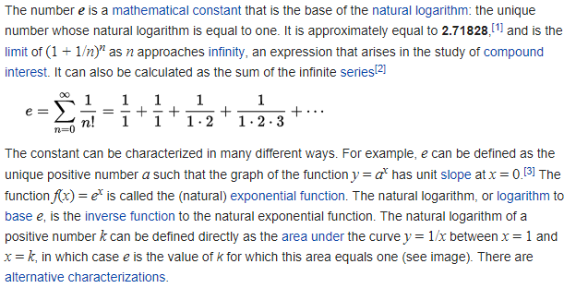
e (mathematical constant)
https://en.wikipedia.org/wiki/E_(mathematical_constant)

Slide 7
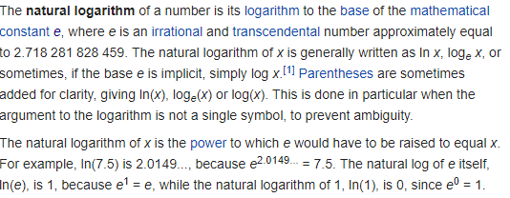
Natural Logarithm
https://en.wikipedia.org/wiki/Natural_logarithm

Slide 8
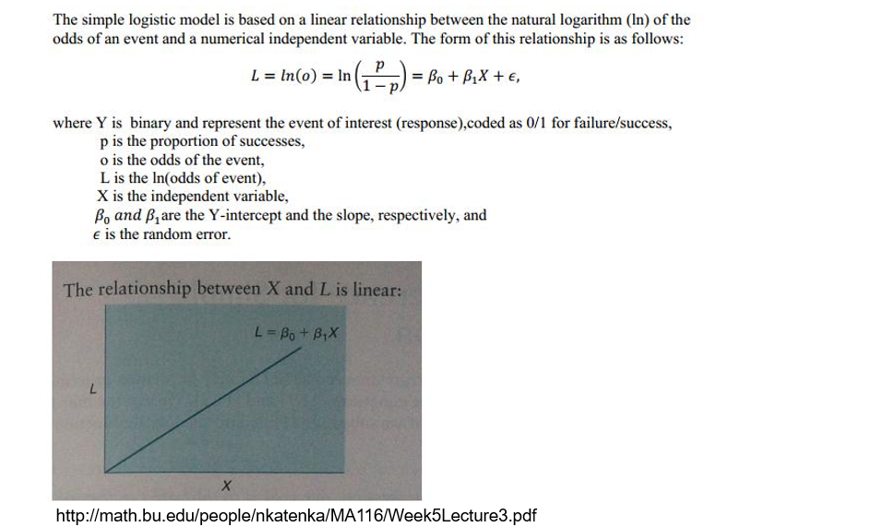
Logistic Regression Equation

Slide 9
Creating the Dataset for Performing Logistic Regression

Slide 10

Importing Required Packages
Import Packages

Slide 11
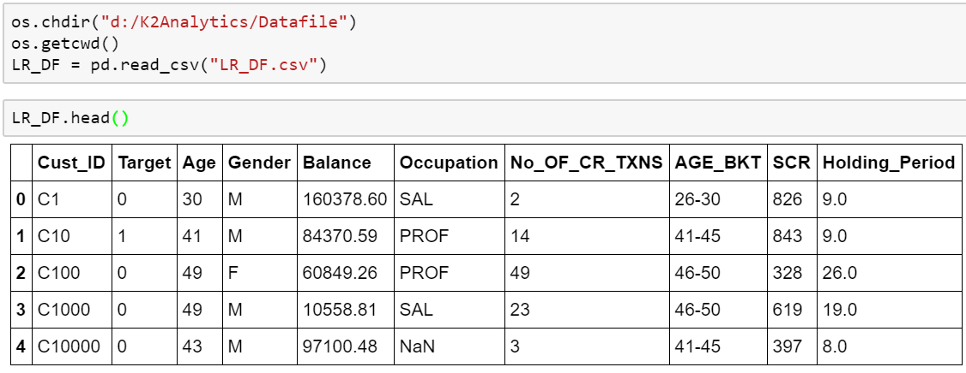
Setting working directory and importing data

Slide 12
Exploratory Data Analysis

Slide 13
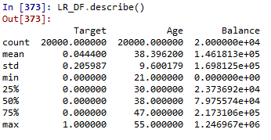
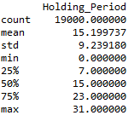
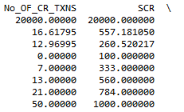
Getting summary statistics
Read & interpret the summary statistics properly like:
Min-Max range for continuous variables
Mean , Median , Standard deviation , Quantile deviation values for continuous variables
Count for continuous variables

Slide 14
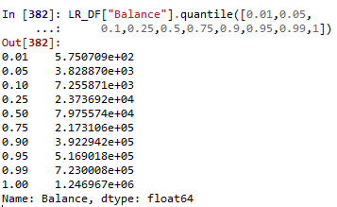
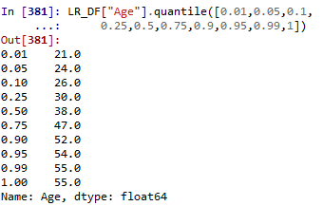
Getting percentile distribution

Slide 15
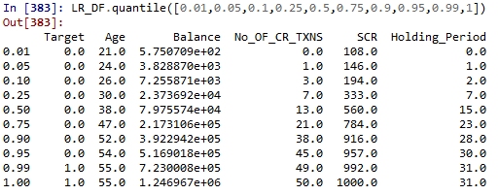
Getting percentile distribution for all numeric variables

Slide 16
Performing Basic Transformation Capping & Flooring Missing Value Imputation

Slide 17
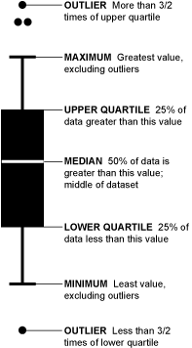
Outlier treatment | Capping & Flooring
Typically we floor and cap variables at
p1 and p99 percentile
or (Q1 – 1.5 IQR) and (Q3 + 1.5 IQR)
or based on Business Judgment
Box Plots helps quickly identify presence of outliers

Slide 18
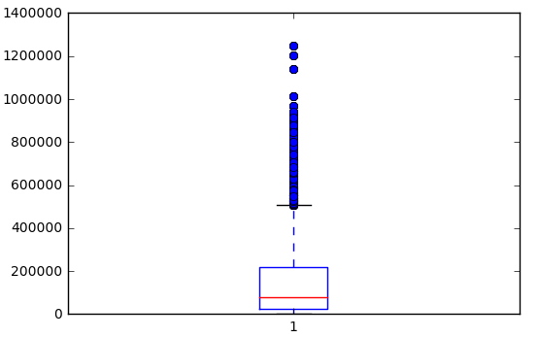
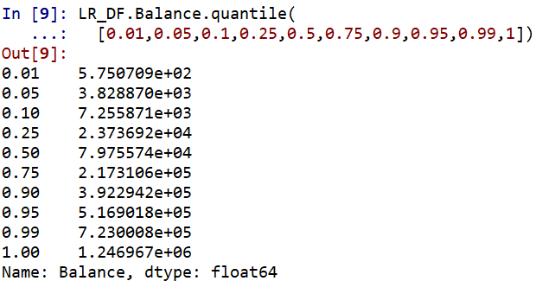

Outlier treatment for Balance Variable

Slide 19
Missing Value Imputation
Imputation is the process of replacing missing data with substituted values
In Python, missing values are indicated by NAN
Simple missing value imputation techniques
Mean, Mode imputation
Using information from related observations
Imputation based on logical reasons
Creating missing category

Slide 20
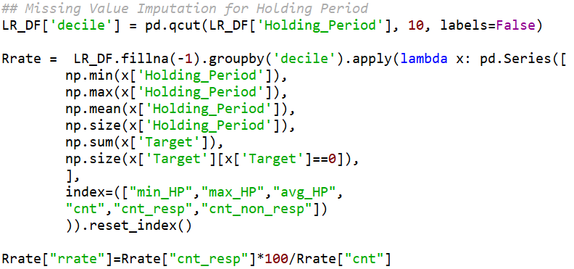
Missing value imputation…

Slide 21
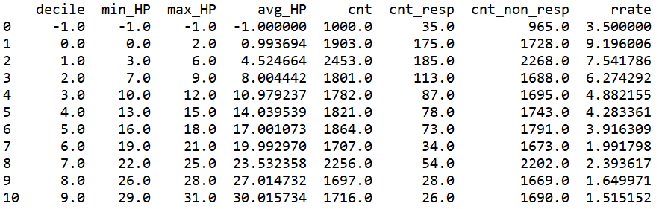
Response Rate table

Slide 22
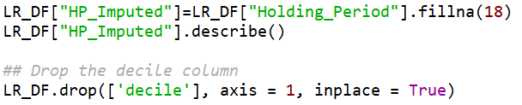
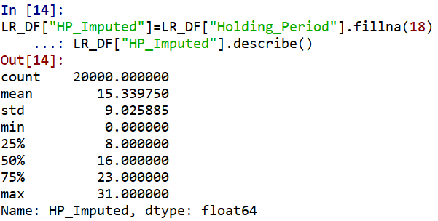
Imputing Holding Period value

Slide 23

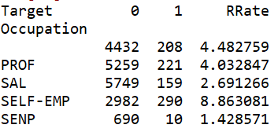
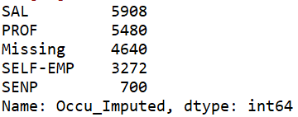
Missing value treatment for categorical variable…
Approx 25% of observations have missing values

Slide 24
Significant Variable
Visualization and Pattern Detection

Slide 25
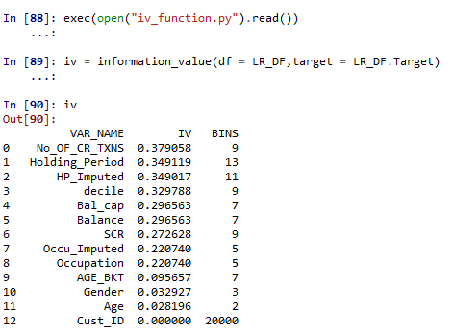
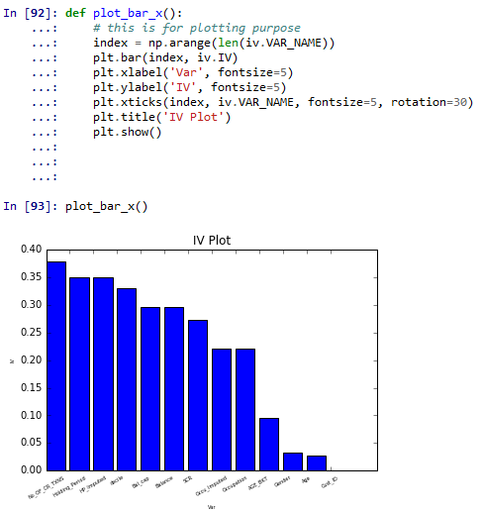
Information Value
http://blog.k2analytics.co.in/2014/06/information-value-concept-in-scorecard-development/

Slide 26
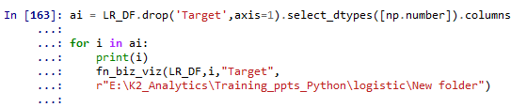
Visualization Code

Slide 27
Holding Period

Slide 28
Age

Slide 29
Model Development

Slide 30
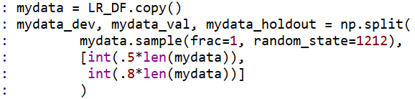
Dev – Val – Hold Out Sampling
## Sampling Code
Modeling Base
Development
Sample
50%
## Checking the samples
Validation
Sample
30%
Hold Out
Sample
20%

Slide 31
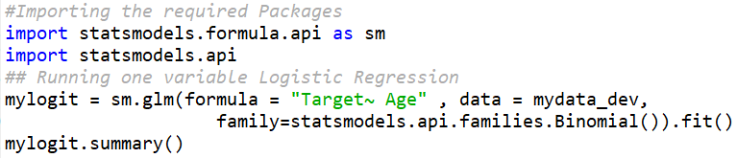
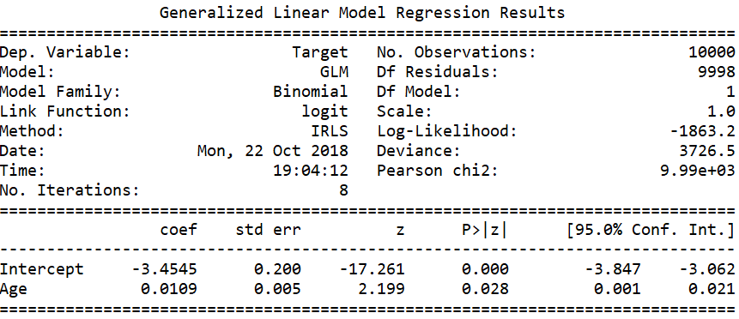
Running One Variable Regression with Age
Age variable is not significant at
alpha = 0.0001

Slide 32
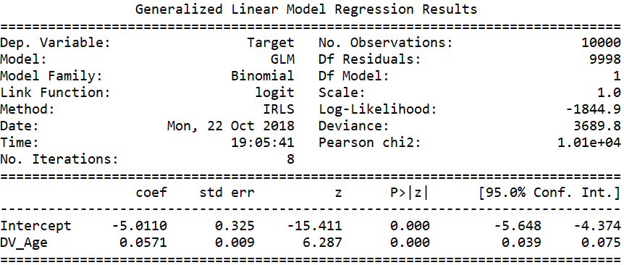
Running One Variable Regression with DV_Age
Transformed Age variable is significant at
alpha = 0.0001

Slide 33
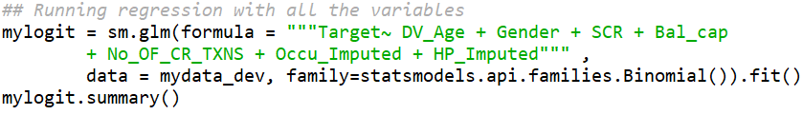
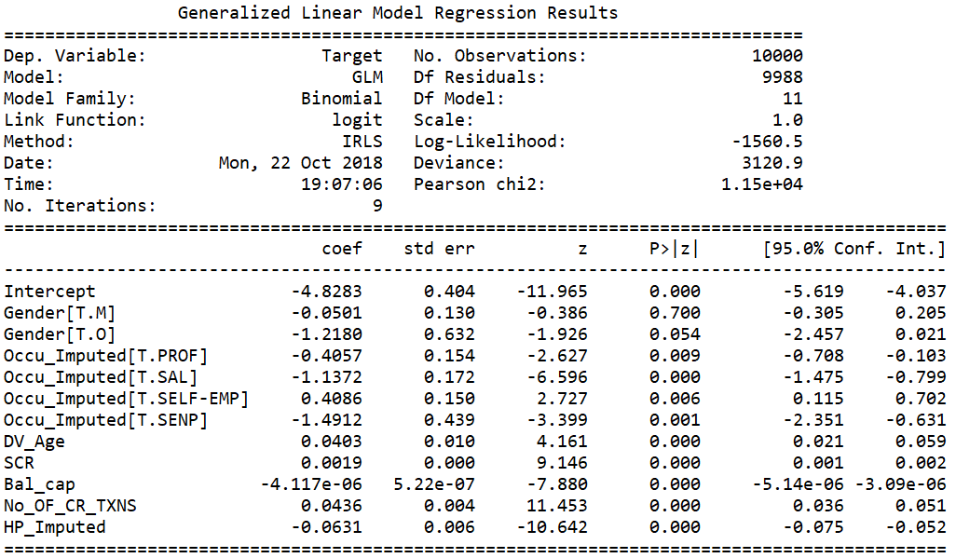
Running Regression with all variables
Gender is insignificant as such we must drop this variable

Slide 34
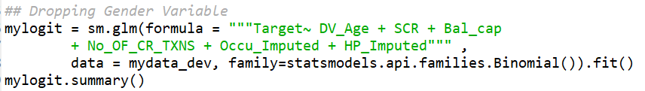
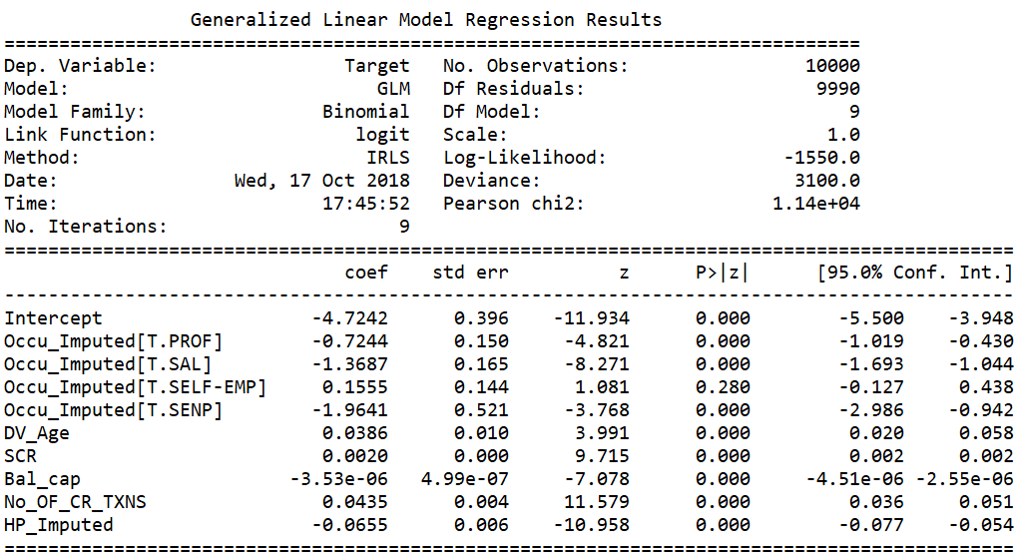
… dropping Gender variable from regression
Check the sign of variable beta and ensure they are inline with the trend
Ensure there is no sign change of estimate

Slide 35
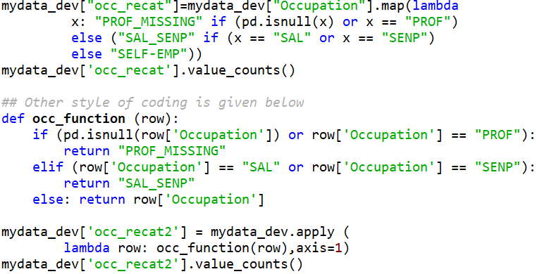
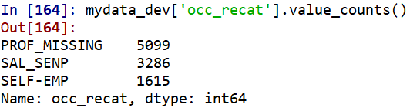
Occupation variable transformation

Slide 36

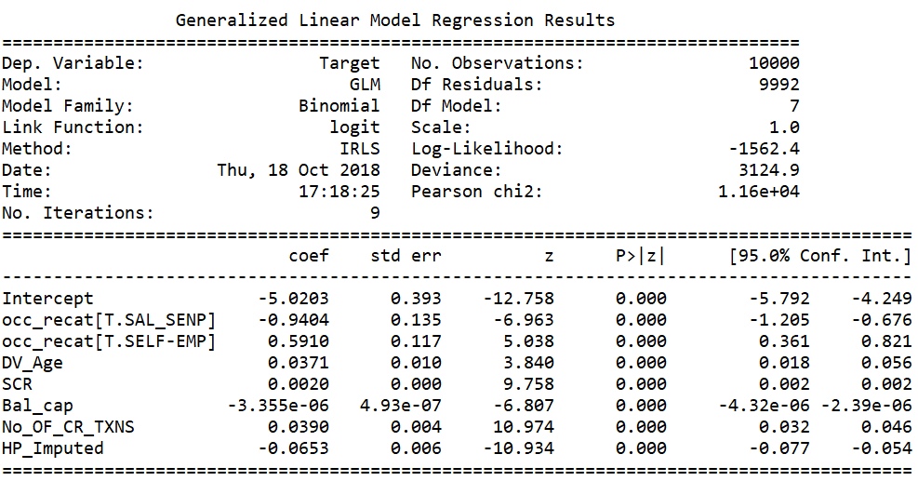
…with recategorized occupation variable
Occupation variable betas are now stable

Slide 37
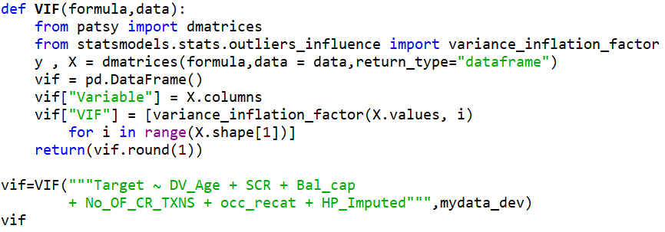
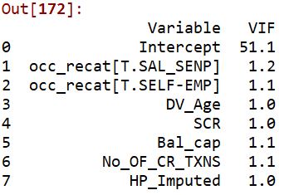
Check for Variance Inflation Factor (VIF)

Slide 38
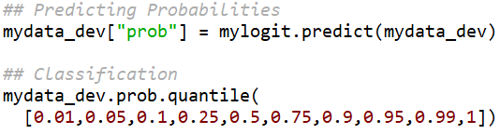
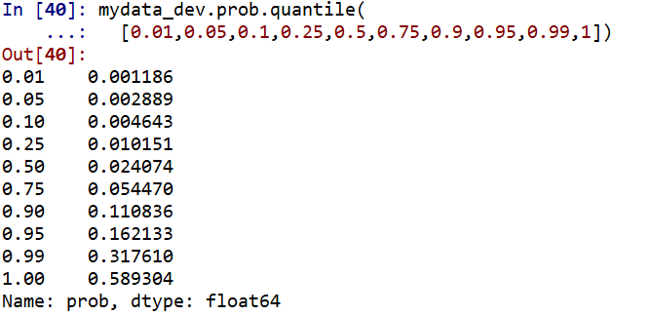
Predicting Probability & Class
Note 99 percentage of observation have probability less than 0.5. If we use 0.5 as cut-off then only 1% cases will be classified as responders
Using 0.956 as cut-off will ensure atleast 4.4% customers are classified as Responder based on the model.

Slide 39
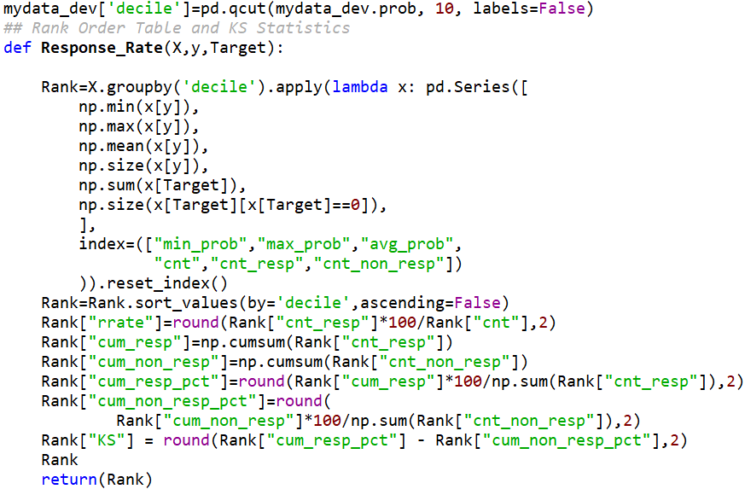
Model Performance Measures | Rank Order & KS

Slide 40
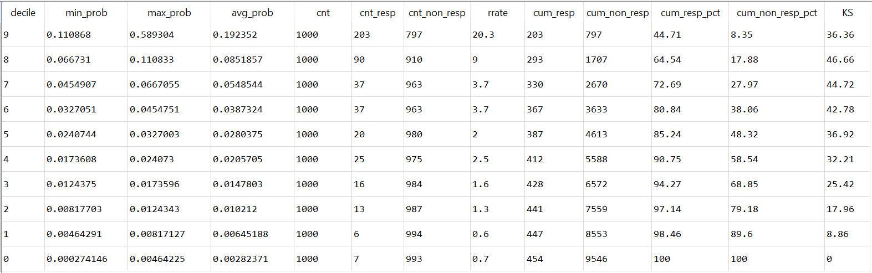
Rank Order table output

Slide 41
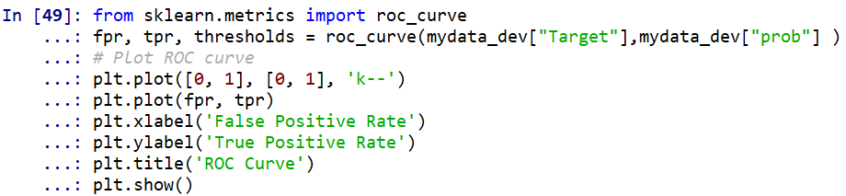
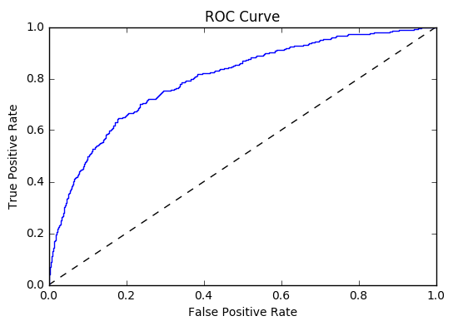


ROC Curve and KS Statistics

Slide 42
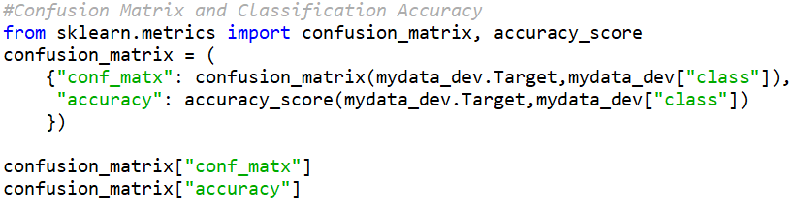
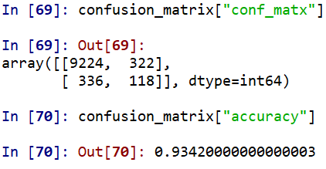
Confusion Matrix (Contingency Table)

Slide 43
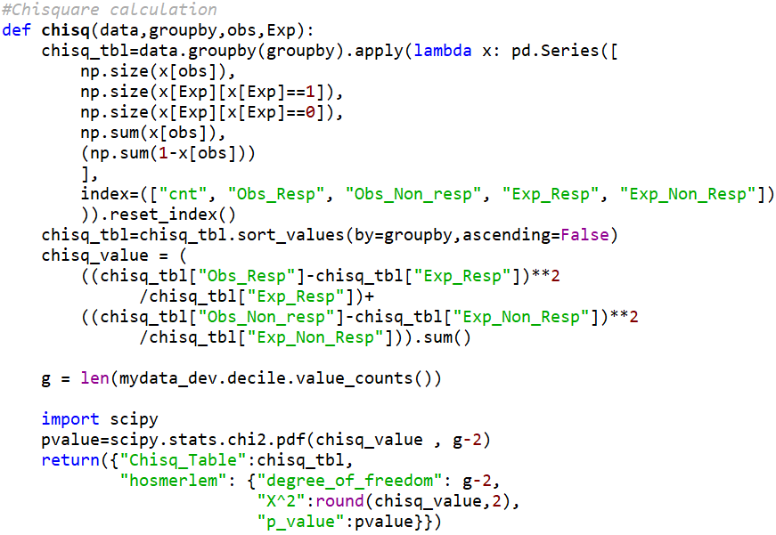
Hosmer-Lemeshow Goodness of Fit test

Slide 44
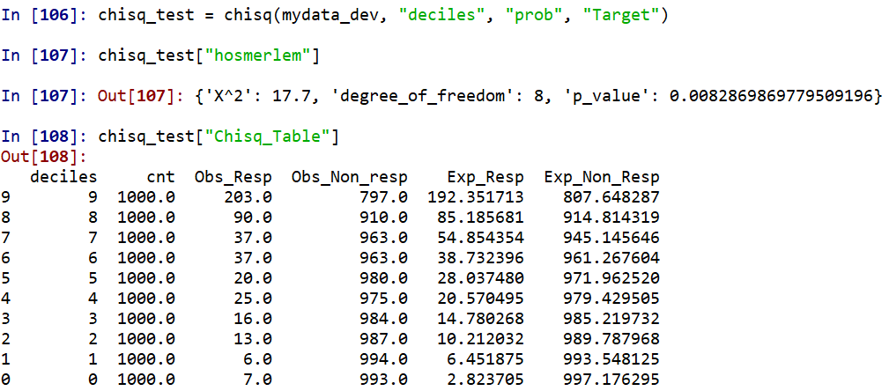
Model HL –Goodness of Fit test

Slide 45
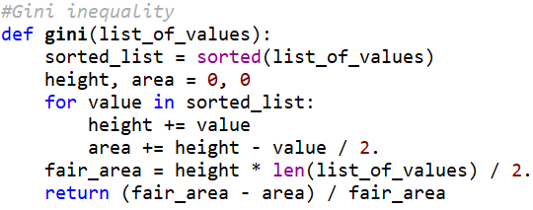

Gini Coefficient
https://planspace.org/2013/06/21/how-to-calculate-gini-coefficient-from-raw-data-in-python/

Slide 46
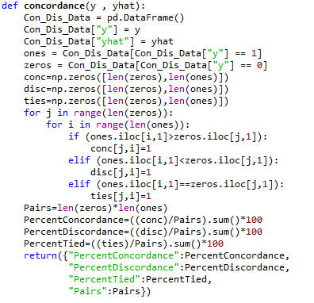
Code for Calculating Concordance
The code take too long to execute.
Note Concordance value is equal to AUC value

Slide 47
Model Validation

Slide 48
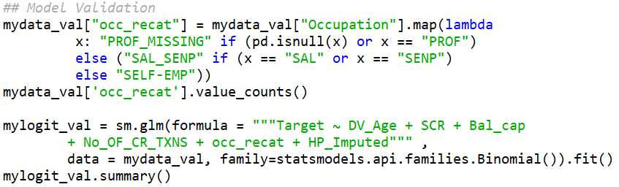
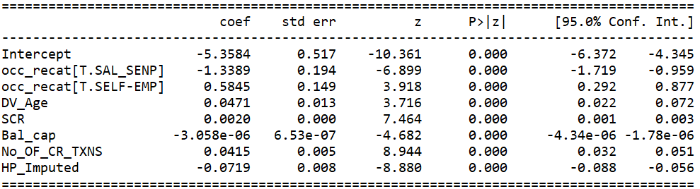
Model Validation

Slide 49
Model Validation | Dev / Val Ratio
Variable | Dev. Estimate | Val. Estimate | Beta Ratio
Intercept | -5.0485 | -5.3584
occ_recat[T.SAL_SENP] | -0.8911 | -1.3389 | 1.50
occ_recat[T.SELF-EMP] | 0.6542 | 0.5845 | 0.89
DV_Age | 0.0394 | 0.0471 | 1.19
SCR | 0.0019 | 0.002 | 1.05
Bal_cap | -3.95E-06 | -3.06E-06 | 0.77
No_OF_CR_TXNS | 0.0402 | 0.0415 | 1.03
HP_Imputed | -0.0626 | -0.0719 | 1.14

Slide 50
Further Validation to be performed
Check the Model Performance Measures on Validation Sample
Rank Ordering
KS
Lift Chart
Gini Coefficient
Check the Model Performance Measures on Hold Out Sample

Slide 51
Lab Assignment

Slide 52
Lab Assignment
Build the Visualization Chart for the following
Balance vs Target
SCR vs Target
Check the Model Performance Measures on Validation Sample
Rank Ordering
KS
Lift Chart
Gini Coefficient
Check the Model Performance Measures on Hold Out Sample

